Slide 1

Global Economic & Demographic Trends Analysis (1960–2016)

Slide 2

Data Architecture & Methodology
Data Sources
SQL Database: Static country and regional reference data
Excel Files: Time-series GDP and population data (1960–2016)
ETL & Data Modelling
Cleaned null values and standardized country names using Power Query
Designed a Star Schema for efficient analytical querying
Statistical Analysis
Calculated Global Mean and Standard Deviation
Identified economic outliers and wealth concentration patterns
Advanced DAX
Implemented Time Intelligence measures
Calculated CAGR (Compound Annual Growth Rate)
Enabled dynamic Top-N country analysis

Slide 3
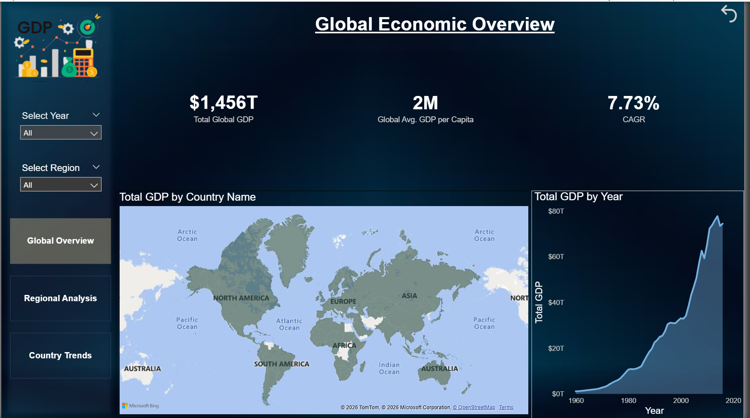
Global Economic Overview
Key Insights
The global economy shows strong
long-term expansion
Total global GDP reached
approximately $1,456 Trillion
Growth Metric
Global CAGR: 7.73%, indicating steady economic acceleration
Geospatial Insight
Economic activity is highly concentrated in the Northern Hemisphere, as shown in the global map visualization

Slide 4
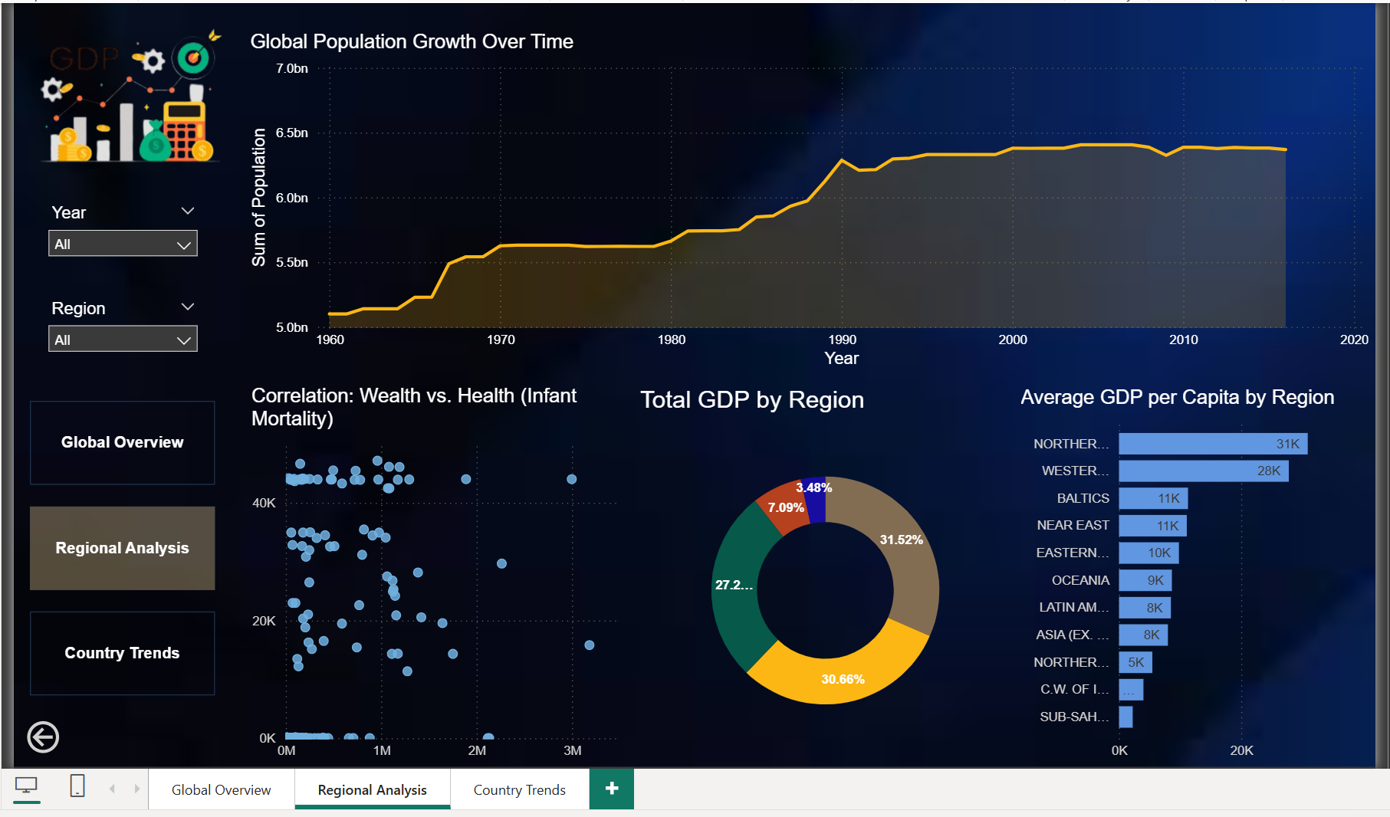
Regional Analysis
Wealth Distribution
North America and East Asia together
contribute over 50% of global GDP
The Demographic Disconnect
Sub-Saharan Africa exhibits the highest
population growth, but it remains a developing economic region.
Correlation Analysis (Wealth vs. Health)
Visual: The Scatter Plot (bottom-left) reveals a strong negative correlation between GDP Per Capita and Infant Mortality.
Finding: As nations achieve higher economic status, infant mortality rates drop significantly, proving wealth is a primary driver of public health outcomes.

Slide 5
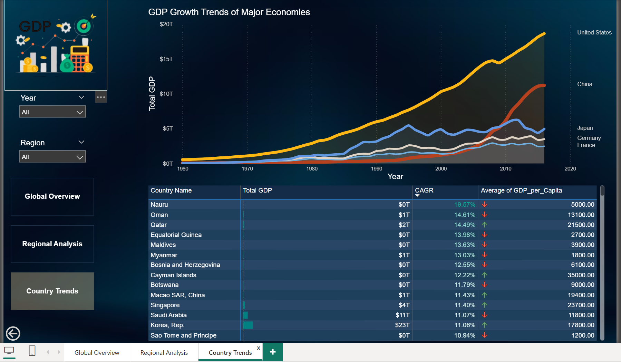
Country Trends & Statistical Validation
Country Growth Patterns
The line chart shows China’s rapid
GDP growth after 2005
The United States remains the largest
economy, but growth competition is increasing
Statistical Validation
Standard Deviation (~$3 Trillion) confirms that top economies are extreme outliers compared to the global median
Growth Speed vs Scale
CAGR analysis shows developing nations growing faster than developed economies

Slide 6
Conclusion & Key Findings
Key Findings
Global wealth is highly concentrated among a small number of major economies
Developing countries show higher growth rates, while developed nations provide economic stability
Project Summary
Successfully integrated SQL and Excel data sources
Applied data cleaning, statistical analysis, DAX modelling, and professional visualisation
Delivered a decision-ready dashboard covering 50+ years of global trends

